Slide 1
IMU Acceleration Magnitude
Smoothed Acceleration Magnitude
FILTER

Slide 2
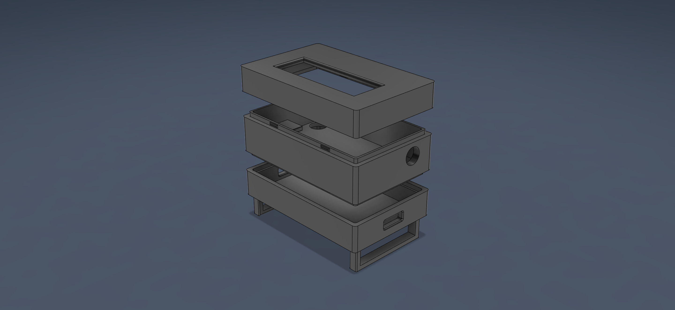

Slide 3
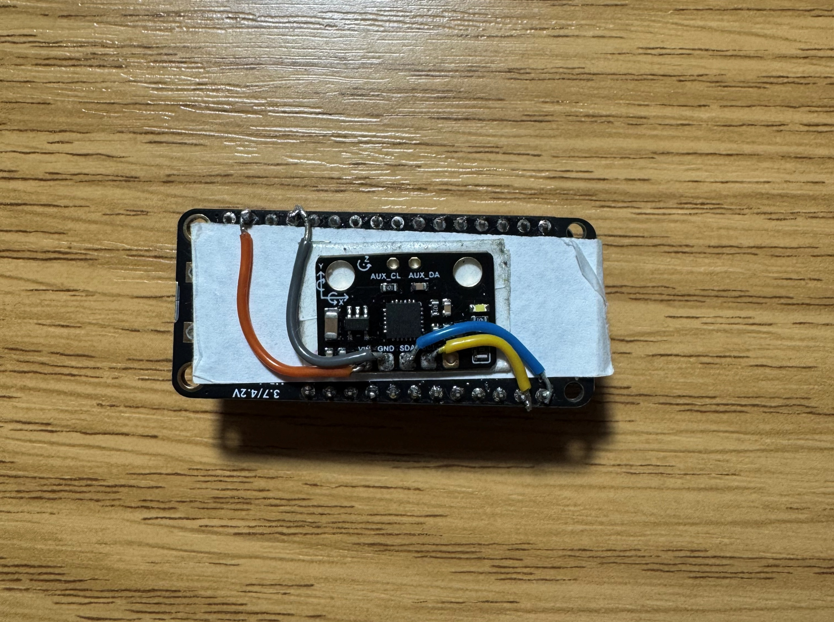
ESP32 MICROCONTROLLER
MPU6050 IMU

Slide 4
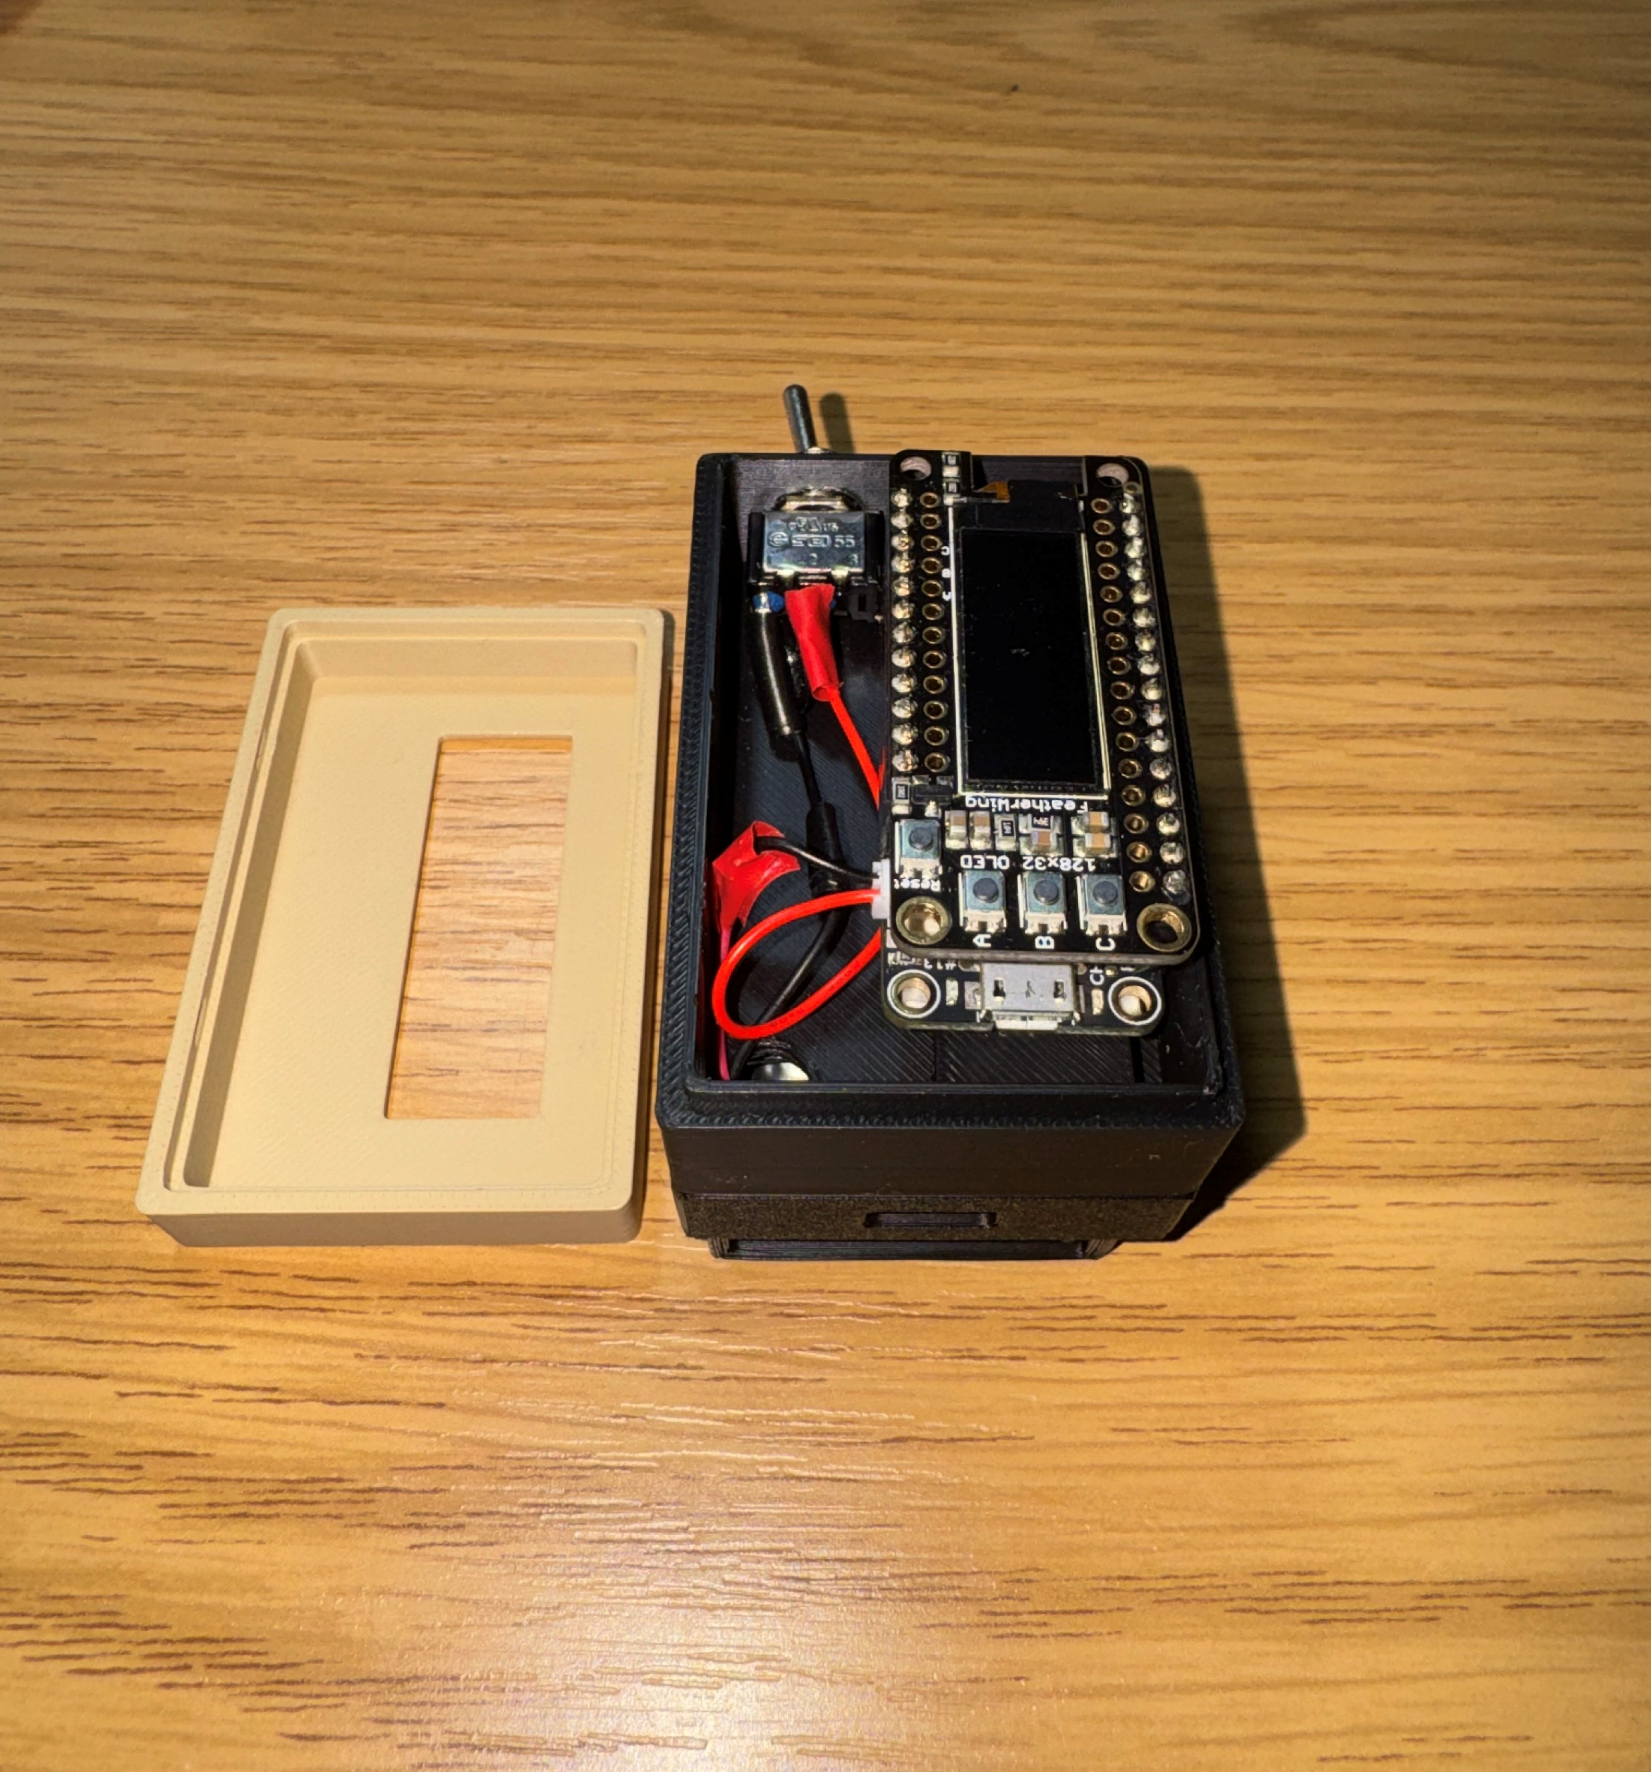
OLED DISPLAY
MICRO USB JACK

Slide 5
